Slide 1
A Data Visualization Using Sentiment Analysis
With a focus on Movies and TV shows

Slide 2
Data Gathering:
Team Bistro would use praw to scrape reddit for the top 50 posts and up to 500 comments within each post, about a certain movie or tv show. We did this for the top 70 movies and tv shows, of all time and the 21st century, and searched the titles within r/movies or r/television respectively.

Slide 3
Sentiment Analysis:
We used VADER sentiment to analyze each comment and post which gave us a value between -10 and 10, who’s value corresponds to the positive or negative connotation of the post/comment.

Slide 4
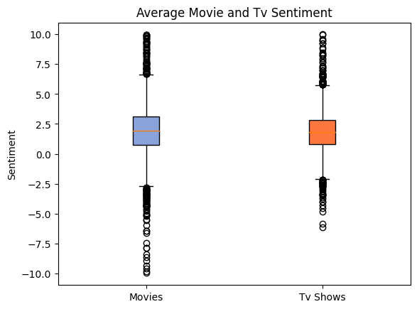
Results:

Slide 5
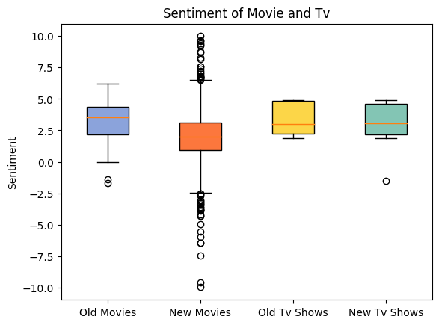
Results Cont.

Slide 6
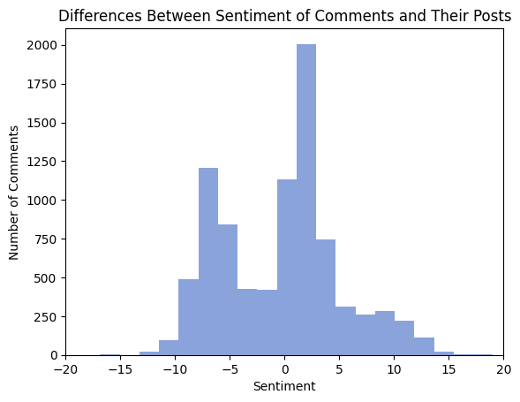
Results Cont.

Slide 7
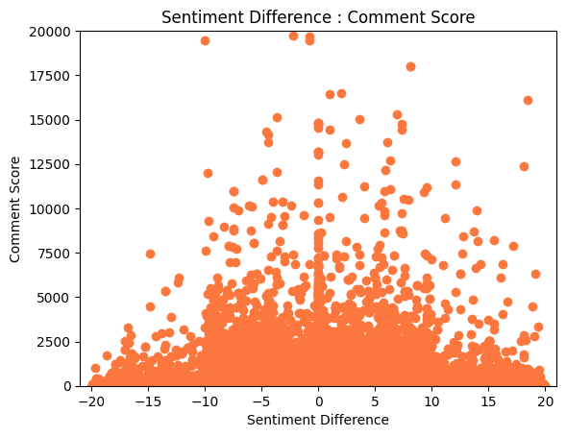
Results Cont.

Slide 8
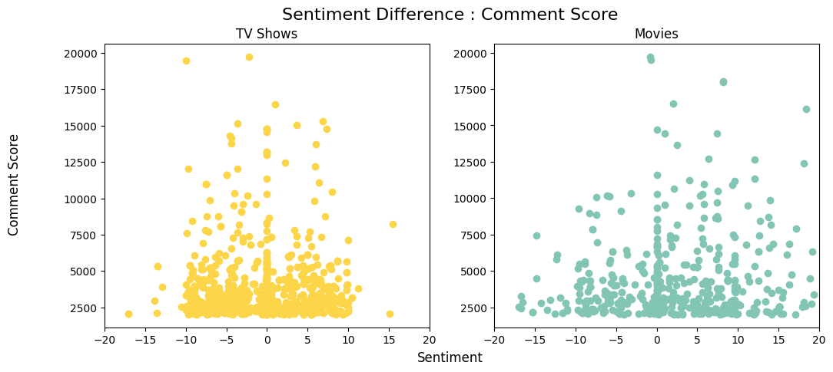
Results Cont.

Slide 9
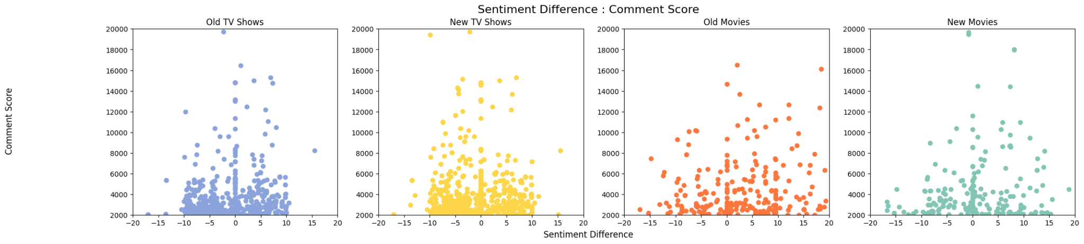
Results Cont.

